Slide 1
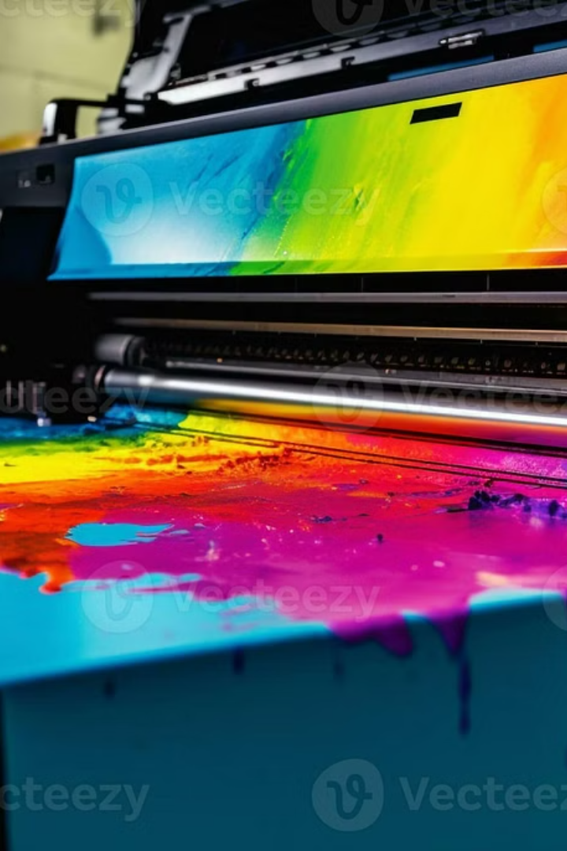
Role of CMY Colour Model in Image Processing & Computer Vision
BY: N SREE SAIRAM RITHIK PRASANNA | AI & DS Dept., Anna University (MIT)

Slide 2
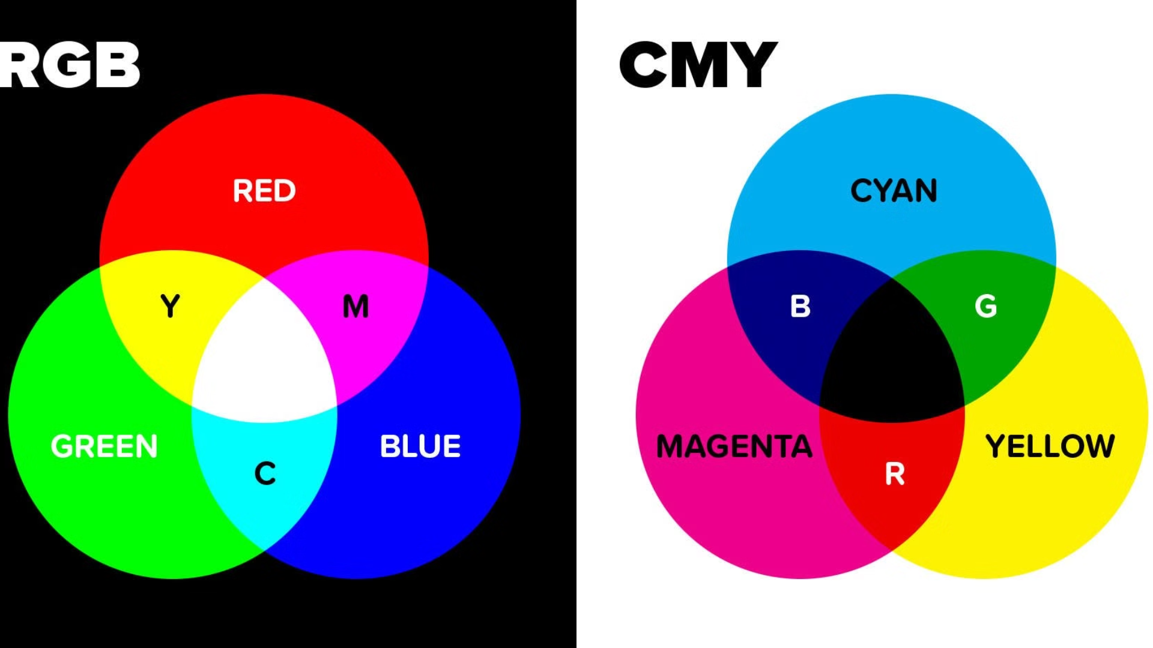



Color Models in Image Processing
Color Representation
Common Models
CMY Use Case
Foundation for computer vision tasks
RGB (Additive light)
Print-based processing and color subtraction
CMY (Subtractive light)
HSV

Slide 3
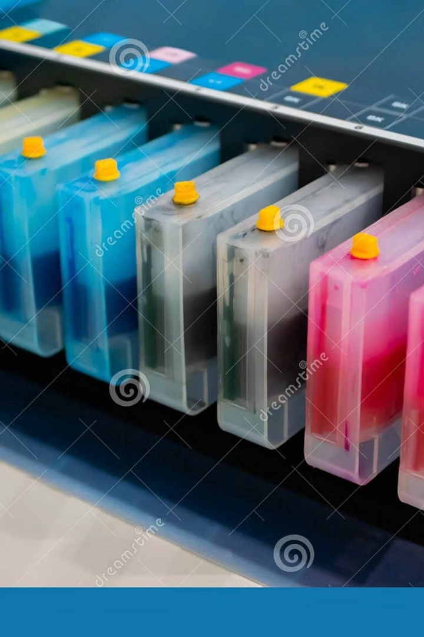




What is CMY?
Components
Cyan, Magenta, Yellow
Model Type
Subtractive: removes red, green, blue
Applications
Print vision, inkjet analysis, pre-press software
Conversion Formula
C = 1 - R, M = 1 - G, Y = 1 - B

Slide 4

Image as a Matrix
Pixel Structure
RGB to CMY Conversion
An image is represented as a matrix with dimensions: height × width × color channels (RGB).
Input RGB values: [0.3, 0.6, 0.9]
Conversion formula: C = 1 - R, M = 1 - G, Y = 1 - B
Each pixel's RGB values are converted individually into CMY values using a subtractive color model.
Converted CMY values: [0.7, 0.4, 0.1]

Slide 5

CMY Conversion (Python Code)
Read Image
1
img = cv2.imread('img.jpg') / 255.0 # Load and normalize image
2
Convert to CMY
cmy = 1 - img # Perform subtractive color conversion
Display Result
3
cv2.imshow('CMY Image', cmy) # Show the converted image
cv2.waitKey(0)
cv2.destroyAllWindows()
4
Application
Improves contrast and is easy to implement in image processing

Slide 6
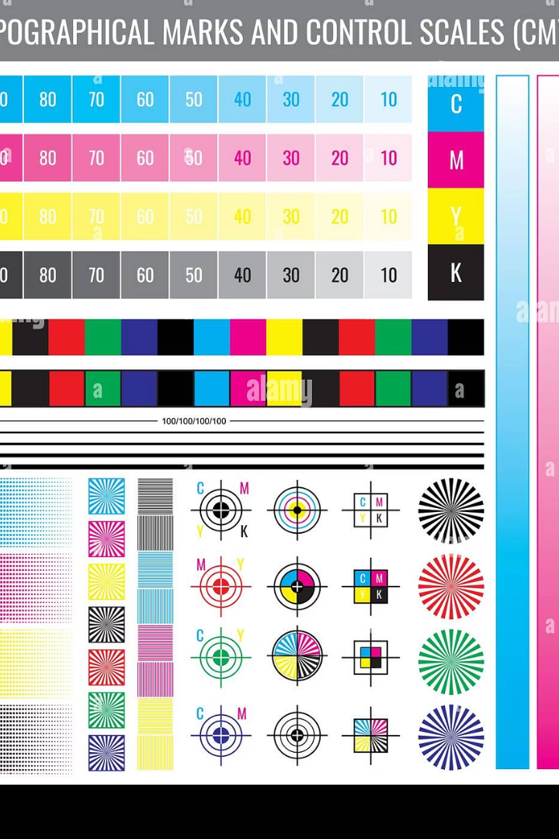
Why CMY in Vision?
Low-light Highlight
Contrast Enhancement
Better visibility in shadows
Between light and dark areas
Print Accuracy
Pre-press alignment and error detection

Slide 7

CMYK in Real-World Processing
Purpose of K (Black)
Uses
Sharper grayscale, avoids dirty blacks
Digital printing
Document scanning
K = min(C, M, Y)
Label verification

Slide 8





Applications of CMY
Print Quality Inspection
Color Separation
Medical Imaging Filters
Publishing industry use
Augmented Reality
Interactive magazine content

Slide 9

Limitations of CMY Model
Not Screen-native
Data Loss
Unsuitable for display devices
Loss during CMY to RGB conversion
Software Support
Limited in OpenCV; prefers RGB/HSV

Slide 10
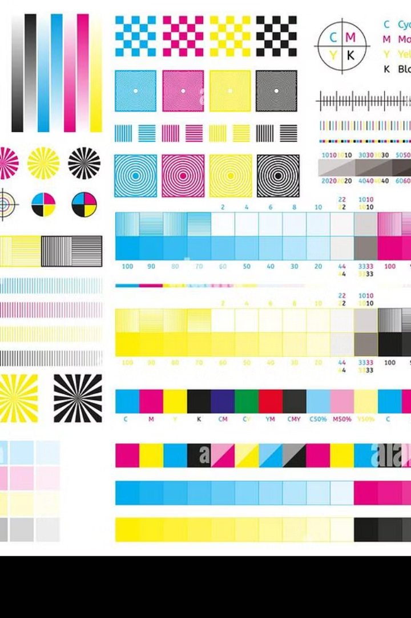




Conclusion: CMY in Image Processing
Essential in print-focused computer vision
Relies on matrix subtraction for color transforms
Limited in real-time video but strong in inspection tasks
Underrated model for precision printing vision

